Slide 1
The Innovative Pro Assistant
Butrind Zekaj & Oliver Richani

Slide 2
Personas
Raj
Raj, age 41, living in Mumbai in India, is a full-time IT Support for our client’s company
He has been with the company for 10 years but has also experience as a phone operator from previous jobs and developer for a small Indian company.
As a tech-enthousiast, he acquired programming skills from classes on Coursera (i.e., Java and OOP).
Relevance : Raj hopes he could help more clients if the Assistant is able to provide him specific documentation and to solve client’s issues quicker
Markus
Markus, age 25, living in Boston, has completed his MBA two years ago with a specialization in Customer Relationship Management at Harvard University.
Throughout his studies, he gained interesting knowledge such as Leadership but also became an expert in the use of CRM software such as Salesforces.
Relevance : Markus hopes that he will be able to better manage his tasks and focus on those that are more important for the company and thus remain just as effective

Slide 3
Personas (2)
Nelly
Nelly, age 22, living in the same town as our client's company
Recently graduated with a bachelor’s degree in marketing with a specialization in Sales
As a new employee, she is unfamiliar with the technological tools and often needs to be assisted with small tasks and feels like she bothers colleagues
Relevance: She hopes it will help her to fill in the gaps and allowing her to independently handle administrative tasks and reduce her dependance on colleagues.
John
John, age 52, living in Geneva, is an experienced full-time manager working for the client’s company.
Obtained the PMP certification and worked for 30 years in the company
Strong basis in Data Analysis and expertise in project management software (i.e. Jira)
Relevance : With the increasing complexity and number of projects, John is seeking a software solution that offers seamless communication, real-time project tracking, and efficient task distribution.

Slide 4
Scenario
John has to manage a multitude of projects within the company this year, including one involving a lot of employees from different departments. He knows from experience that communication and coordination is time-consuming and that there may be misunderstandings about deadlines and expectations due to disorganized information distribution. However, since it’s an important project he must ensure that it stays on track and that tasks are completed on time to avoid delays. With the Innovative Pro Assistant, John can log into the system with his personal and secure credentials and can track the progress provided he has the access rights. Then, if needed he can send notifications to specific employees to assign new personal tasks or warn them of tasks to be completed, upcoming meeting or even to set a new one. To do so, John can choose how he wants to send his notification. It can be by email or use the Assistant’s In-App notifications

Slide 5
Scenario (2)
Markus has to schedule a meeting with an important client. He wants to prepare in advance for the meeting since he has a lot on his plate, and setting up this meeting could take a lot of time if he has to do everything by himself. To be more efficient and save time for his other tasks, he decides to use the Innovative Pro Assistant provided by his company. To do so, he logs into the system using his personal and secure credentials. First, he sets the meeting date to ensure he doesn’t forget it, then he reserves an available room in advance. Markus can also quickly and easily send queries to the Assistant to access specific client information, like personal details, past purchases, and an indicator of the client’s relationship with the company, provided he has the necessary access rights.

Slide 6
Scenario (3)
Nelly has been hired very recently at the company and is still taking her marks. Today her superior asked her to order office supplies using a form in which she needs to specify quantities. However, she is especially unfamiliar with the specifics of the company’s internal forms. She’s not sure which one to choose, how to fill it correctly and she always feels embarrassed asking for help to her colleagues. Hopefully, she remembers a colleague mentioning that the new Innovative Pro Assistant of the company was very useful when facing administrative challenges. Nelly proceeds to log in the server with her company credentials and is directly greeted by the AI in the chat, letting her know she can ask about pretty much anything. She prompts the Assistant with a question about how to find the form she needs to fill-in, as well as how to fill it correctly. The Assistant answers back by providing the appropriate form and a detailed procedure.

Slide 7
User Stories
Markus
As Markus, a client relation specialist, I want to send queries to the server to retrieve specific client information such as previous interactions and purchase history, so that I will be well-prepared for the meeting.
As Markus, a client relation specialist, I need the Innovative Pro Assistant to verify if I have the rights to access personal information about the client, so that data security is not compromised, and sensitive and important information is not leaked.
John
As John, a project manager, I want to use the Innovative Pro Assistant to track the progress of each project, so that I can ensure all tasks are following the objectives and avoid potential delays.
As John, a project manager, I want to use the Innovative Pro Assistant to notify team members of upcoming meetings or any changes to previous ones, so that each member is informed and will be able to adjust his schedules accordingly.

Slide 8
User stories (2)
Nelly
As a new employee, I want to be able to access easily and efficiently all specifics forms I need for my tasks, so that I can finish my administrative tasks without having to always asks my teammates.
As Nelly, a new employee, I need to have an intuitive and friendly experience with the Assistant including a tutorial guide when I log in for the first time, so that I better understand the functionalities provided and it will facilitate my integration within the company.
As Nelly, who has no knowledge of technology, I need to be sure that I can log in securely using my company credentials, receiving a two-factor authentication prompt to verify my identity so that I can perform my personal queries and ensure that my data will be protected

Slide 9
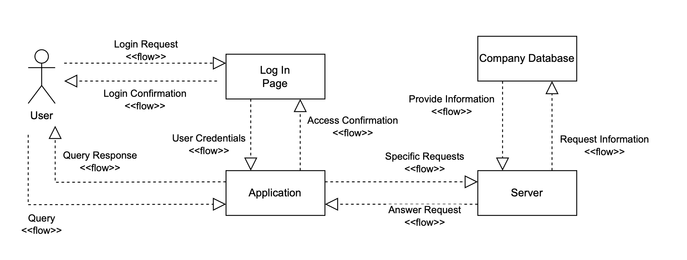
UML Information flow

Slide 10
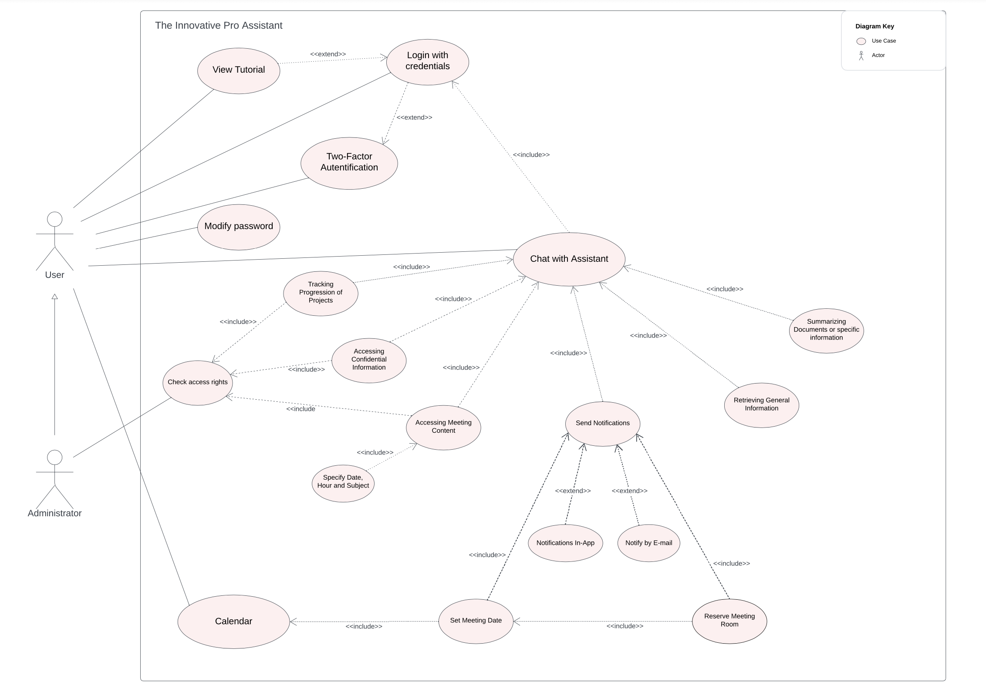
UML Use Case Diagram

